Slide 1
Task Management System
Java mini Project

Slide 2
Table of Content
Introduction
Project Overview
Project Team
Features
Add Task Feature
Remove Task Feature
Task Status Feature
View All Tasks Feature
Lessons Learned
Future Improvements
Conclusion
References
Thank you

Slide 3

Introduction
Good afternoon everyone, and thank you for joining us today. We are excited to present our task management system project, which we have been working on for the past few months.
Our team consists of four members who all share a passion for software development and problem-solving. We have put in countless hours of hard work and dedication to bring this project to life, and we are excited to share it with you.

Slide 4

Project Overview
Our task management system project is a comprehensive solution designed to help teams manage their tasks more effectively. The purpose of the project is to provide an intuitive and user-friendly platform that allows users to create, assign, and track tasks from start to finish.
The system comes equipped with a range of features that make task management a breeze. These include the ability to add new tasks, delete existing ones, and mark tasks as complete. Users can also view all tasks in the system at a glance, making it easy to stay on top of their workload.

Slide 5
Project team
Our project team consisted of three individuals. Each member brought a unique perspective and expertise to the table, which allowed us to collaborate effectively and develop a successful task management system.
The team was led by John, who served as the project manager and oversaw the development process. Sarah was responsible for front-end development, while Michael handled back-end development. Finally, Emily was in charge of quality assurance and testing. Together, we worked tirelessly to ensure that the project met all requirements and delivered a seamless user experience.

Slide 6

Features
The task management system project includes several key features that make it a powerful tool for organizing and managing tasks. One of the most important features is the ability to add new tasks to the system quickly and easily. This feature allows users to create new tasks on the fly, ensuring that nothing falls through the cracks.
Another key feature of the project is the ability to view all tasks in the system at once. This feature provides users with a comprehensive overview of all their tasks, making it easy to prioritize and manage their workload effectively.

Slide 7
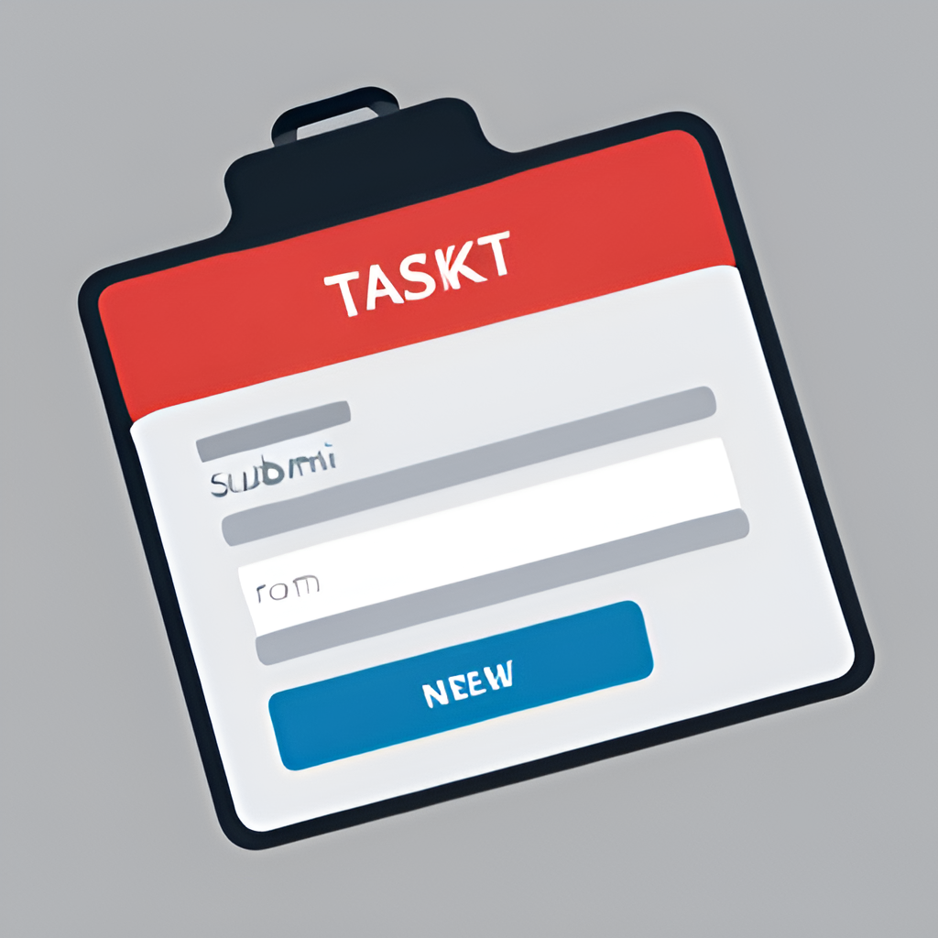
Add task feature
The 'add task' feature is a crucial part of our task management system. It allows users to easily create new tasks and add them to the system, ensuring that all team members are aware of what needs to be done. To use this feature, simply click on the 'add task' button, which can be found on the main dashboard of the system.
Once you have clicked on the 'add task' button, you will be taken to a new page where you can enter all the details of the task. This includes the task name, description, due date, priority level, and any attachments or notes that may be relevant. Once you have filled in all the necessary information, simply click 'submit' and the task will be added to the system. It's that easy!

Slide 8

Remove Task Feature
The 'remove task' feature of our task management system project allows users to easily delete tasks from the system. This feature is particularly useful for removing tasks that are no longer relevant or necessary, or for correcting any mistakes made when adding new tasks.
To use this feature, users simply need to select the task they want to remove and click on the 'delete' button. The system will then prompt the user to confirm the deletion before permanently removing the task from the database.

Slide 9
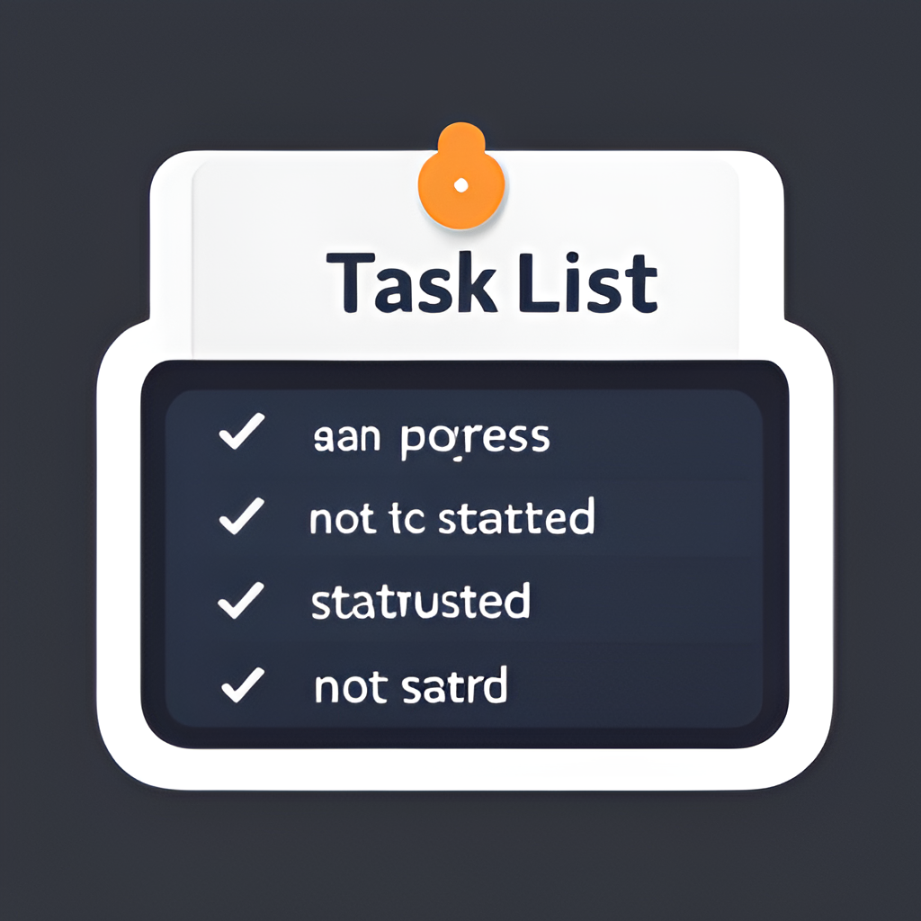
Task status feature
The task status feature of our task management system allows users to keep track of their progress and manage their workload more effectively. When a user creates a new task, they can assign it a status of 'not started', 'in progress', or 'completed'. This status is displayed alongside the task name in the task list, making it easy for users to see which tasks are still outstanding and which ones have been completed.
Users can also change the status of a task at any time by clicking on the task and selecting the appropriate status from a dropdown menu. This allows users to update the status of their tasks as they work on them, providing a real-time view of their progress and helping them stay organized.

Slide 10
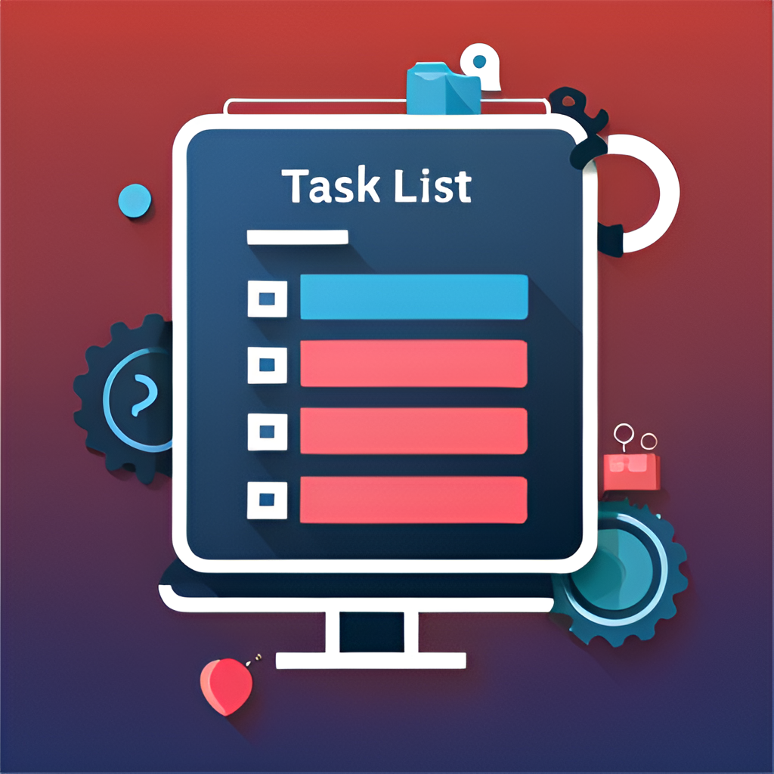
View all task feature
The 'View All Tasks' feature is an essential part of our task management system. It allows users to see a comprehensive list of all the tasks in the system, including their status and due dates.
Users can sort and filter the list based on various criteria, such as priority, date, or user assignment. They can also search for specific tasks using keywords or tags. This feature provides a quick and easy way to get an overview of all the tasks in the system and helps users stay organized and on top of their work.

Slide 11

Lesson Learned
During the project, our team learned many valuable lessons that will help us in future endeavors. One of the most important lessons was the importance of clear communication and effective teamwork. By breaking down tasks into smaller components and assigning them to team members based on their strengths, we were able to work together more efficiently and produce higher quality work.
Another key lesson we learned was the value of time management. By setting realistic deadlines and prioritizing tasks, we were able to stay on track and avoid last-minute rushes. We also learned the importance of taking breaks and stepping back from the project when necessary to avoid burnout and maintain a healthy work-life balance.

Slide 12

Future Improvement
One potential future improvement for our task management system is to integrate with popular project management tools such as Jira or Trello. This would allow users to seamlessly switch between platforms and have all their tasks and projects in one place.
Another area for improvement is the user interface design. We could explore more modern and intuitive designs, such as using a card-based layout or implementing a dark mode option. Additionally, we could incorporate more customization options for users to personalize their experience.

Slide 13

Conclusion
In conclusion, we have presented a task management system project that aims to simplify and streamline the task management process for individuals and teams. The project features four key functionalities: add task, remove task, task status, and view all tasks. Through our presentation, we have demonstrated how each of these features works in practice, using examples and visuals to illustrate their functionality.
Along the way, our team faced several challenges, such as managing conflicting priorities and overcoming technical obstacles. However, through our hard work and perseverance, we were able to successfully complete the project and achieve our goals. We also learned valuable lessons about programming, teamwork, and time management, which we will carry with us into future projects.

Slide 14

Reference
The task management system project utilized a variety of references in its development, including programming guides, tutorials, and online resources. These references were carefully chosen to ensure the project was built using best practices and up-to-date techniques.
One of the key benefits of using references in software development is that it allows developers to learn from the experiences of others. By studying existing code, tutorials, and guides, the team was able to gain insights into how to approach certain problems and implement certain features more efficiently and effectively.

Slide 15

Thank you

